Slide 1

Sensor Kit (Kit 1)
ZAS Robotics Training

Slide 2



Sensor Kit - Contents
Sensor Kit Components
Sensor Creative Board

Slide 3




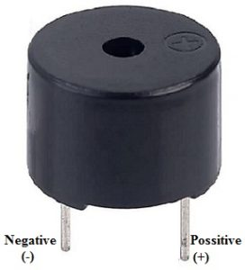
SFL03: BUZZER CONTROL
Things Needed

Slide 4
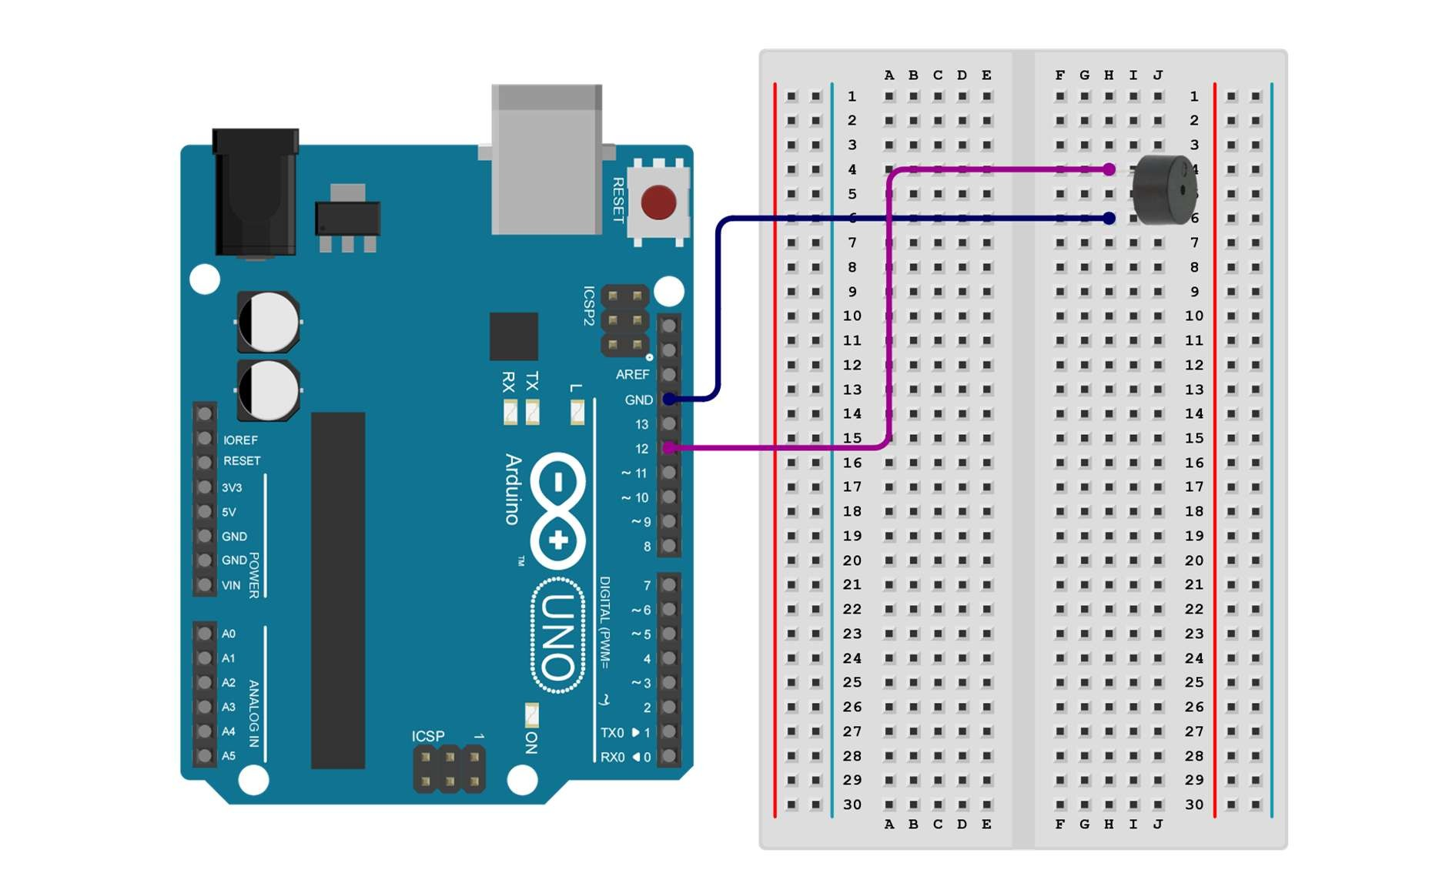
SFL03: BUZZER CONTROL
Connections:
Arduino pins | Breadboard (BUZZER PINS)
GND | NEGATIVE PIN
DIGITAL PIN 12 | POSITIVE PIN

Slide 5
SFL03: BUZZER CONTROL
Define buzzer pin
Setup()
Positive side of buzzer to Digital pin 12
negative side to GND
Loop()
When the microcontroller sends a HIGH signal to the buzzer, it will emit a sound
Code for Lesson SFL03:
https://github.com/info-zas/zas-robotics-sensors/blob/main/01_FoundationProjects/01_Code/_03_GeneratingSoundAlertWithBuzzer/_03_GeneratingSoundAlertWithBuzzer.ino

Slide 6
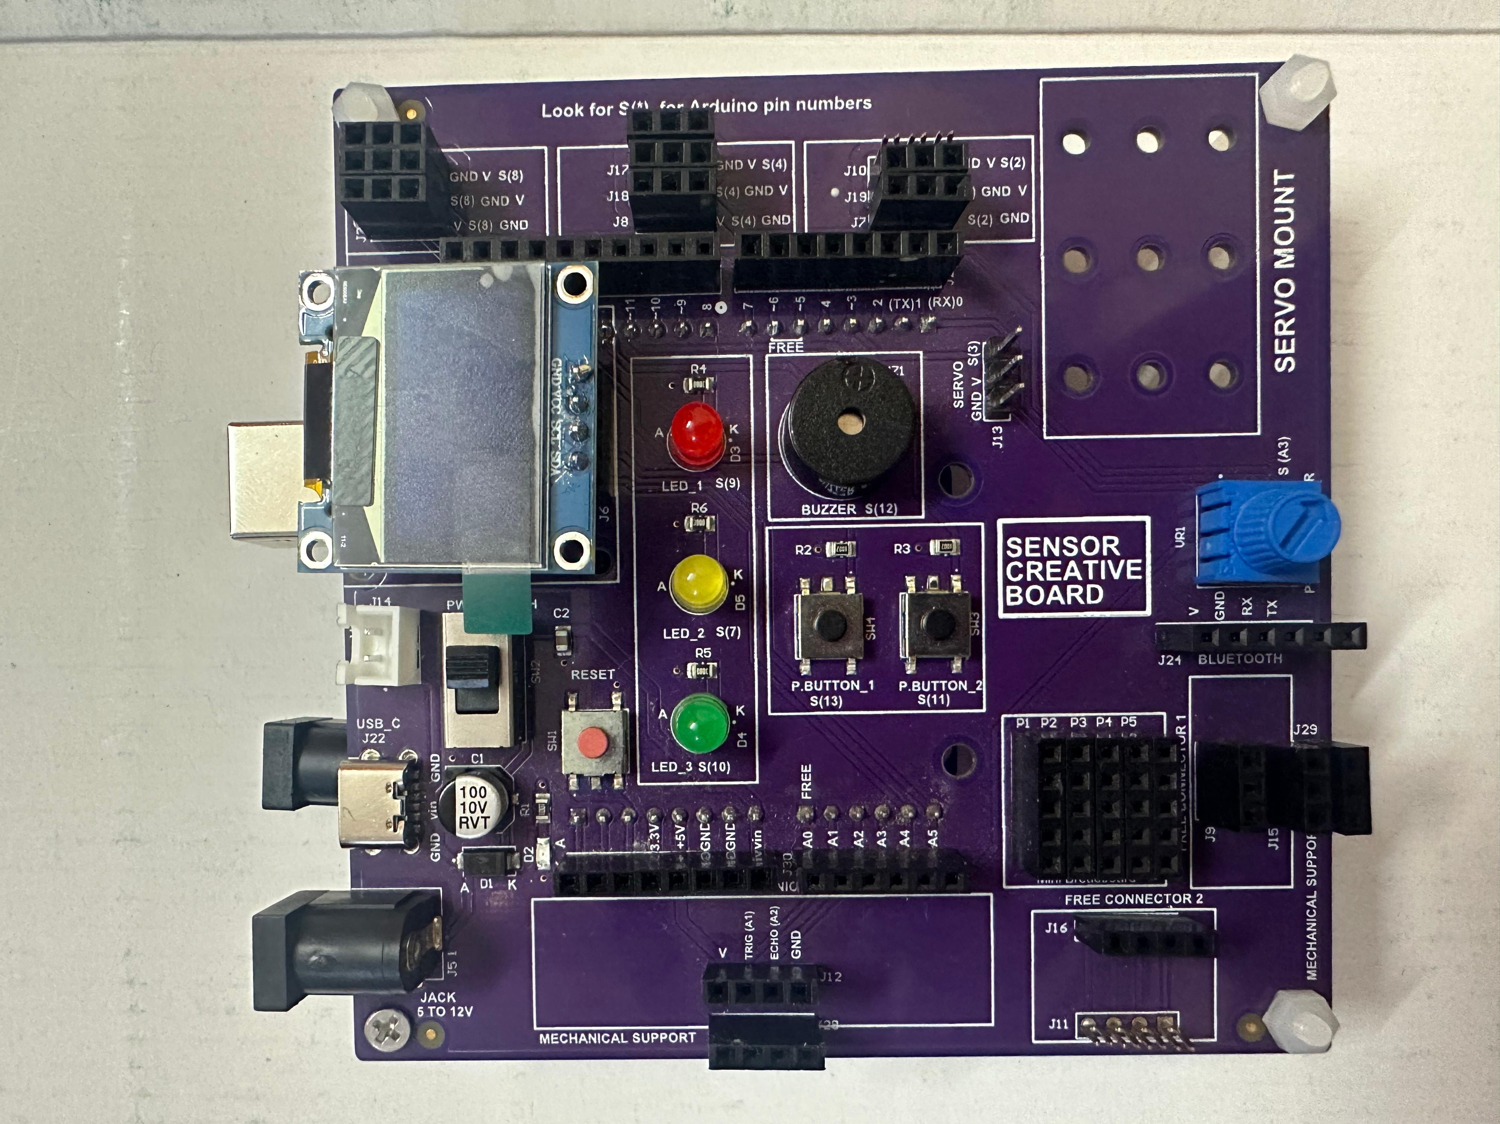
SFL03: BUZZER CONTROL
The buzzer is already mounted on the creativity board.
It is pre-connected to Digital Pin 12 of the Arduino.
No additional wiring or breadboard is needed.
Makes the setup clean and hassle-free.
Allows you to focus on writing code and building the project instead of wiring.

